Slide 1






YOLO
Basic Terminologies
Part Four Mean Average Precision (mAP)

Slide 2
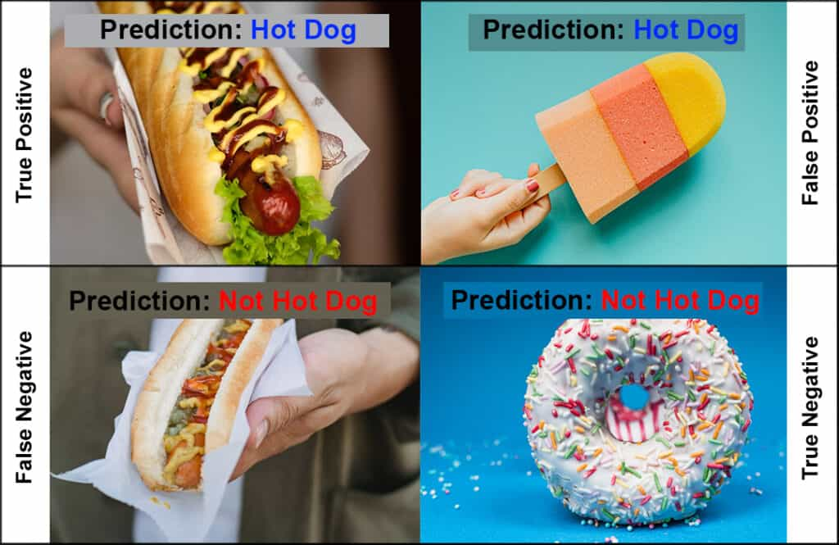
TP, FP, TN, FN

Slide 3






TP, FP, TN,FN
True Positives
False Negatives
There are predicted bounding boxes which have an IOU >0.5 with the target bounding box for a given class.
There are no predicted bounding boxes for a target bounding box.
False Positves
There are predicted bounding boxes which have an IOU < 0.5 with the target bounding box for a give class.

Slide 4
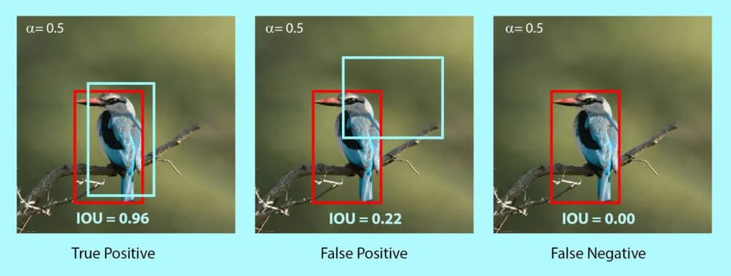
Note that True Negative is not applicable to object detection and segmentation.
It is correctly detecting the background of an object as background.
In other words, it means we didn't output a bounding box that wasn't there.

Slide 5
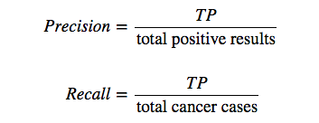
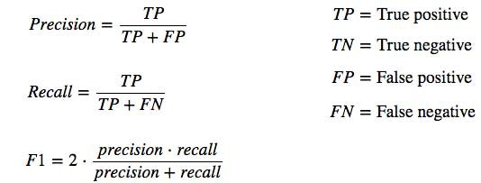
Precision
Precision measures the proportion of predicted positives that are actually correct.
If you are wondering how to calculate precision, it is simply the True Positives out of total detections.

Slide 6
Recall
Recall measures the proportion of actual positives that were predicted correctly.
It is the True Positives out of all Ground Truths.
Recall = TP / Total Ground Truth boxes

Slide 7

Average Precision
AP (Average precision) is a popular metric in measuring the accuracy of object detectors like YOLO, Faster R-CNN, SSD, etc
Average precision computes the average precision value for recall value over 0 to 1.
Average Precision (AP) is not the average of Precision (P).
For simplicity, we can say that it is the area under the precision-recall curve.

Slide 8

Average Precision Use Case
Let us consider the following image that has various classes.
The YOLOv5 nano model is predicting bounding boxes on the objects.
IoU threshold is set at 0.5.
The ground truths are already known.

Slide 9
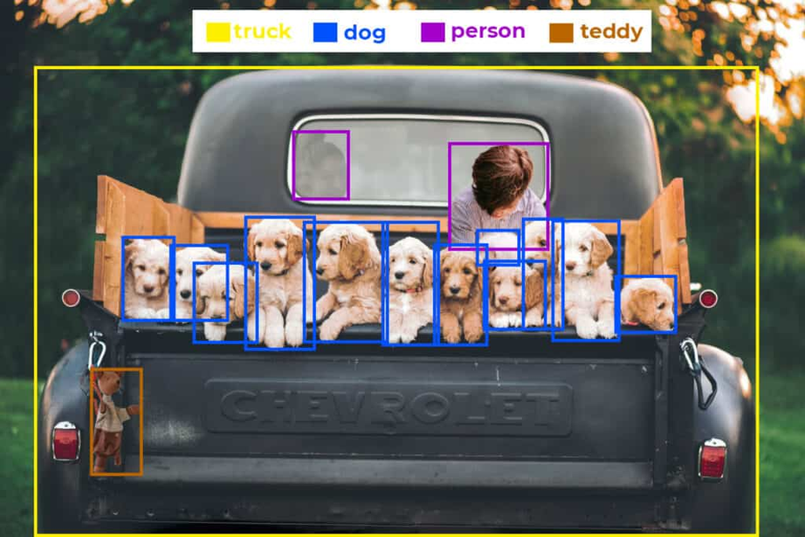
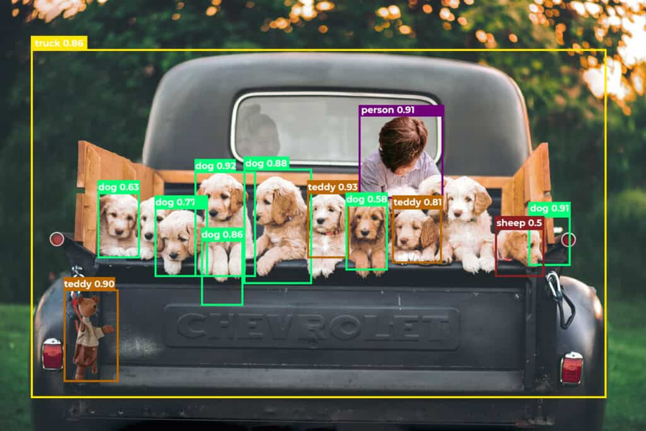
Average Precision Use Case
Ground truths
Predictions by YOLOv5 Nano

Slide 10
We can see that the images have the following objects (Ground Truths).
2 person
12 dog
1 teddy
1 truck
The YOLOv5 nano model has predicted the following objects.

Slide 11
Average Precision Use Case
Average Precision (AP) is calculated class-wise.
Now, let’s get started with calculating AP of dog class.
The steps to be followed are as follows.

Slide 12
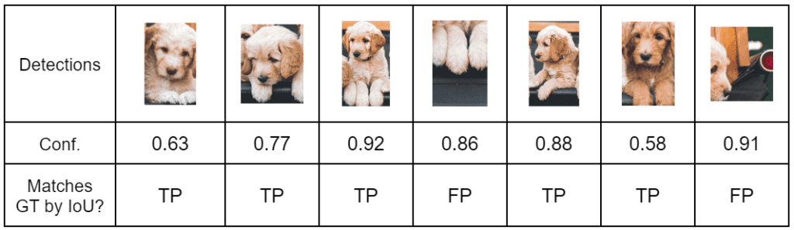
Step 1 - Record every Dog detection along with the Confidence score
TP - If IoU of Predicted box matches GT is > threshold
FP - If IoU of Predicted box matches GT is < threshold

Slide 13
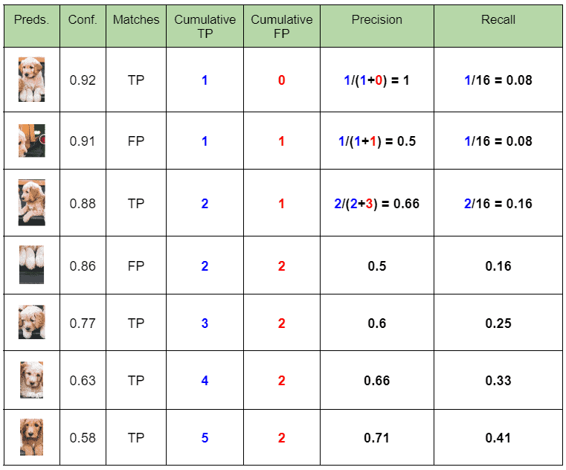
Step 2 - Calculate Precision and Recall
Follow the steps below to tabulate the data.
Sort the table in descending order of confidence.
Tabulate cumulative TP and FP (Keep on adding the current value with the previous row).
Calculate row-wise Precision and Recall.

Slide 14
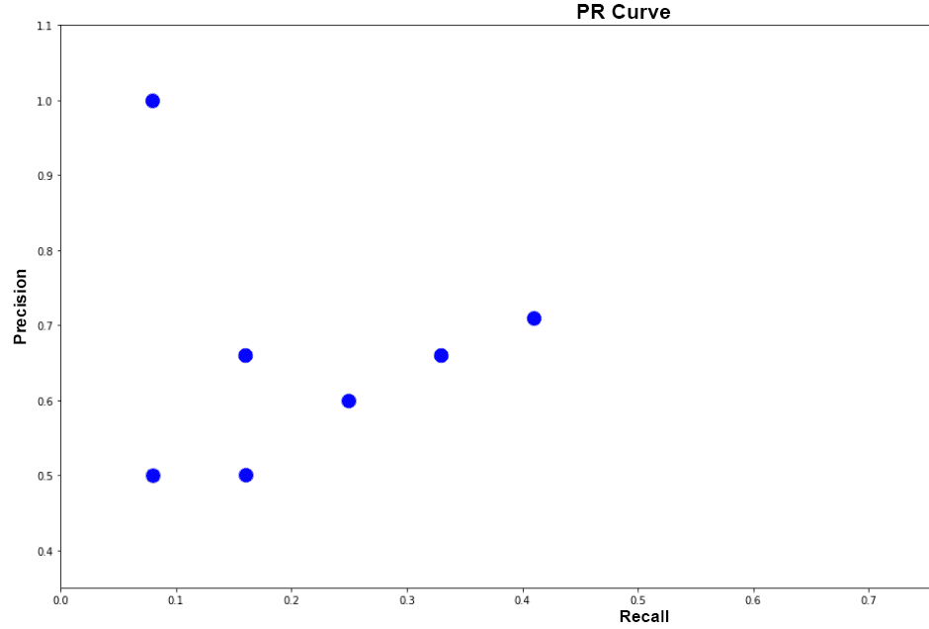
Step 3 - Plot Precision-Recall graph
Note 👉🏼: If the table contains multiple precision values for the same recall values, you can consider the highest value and discard the rest.
Not doing so will NOT affect the final result. This is for simplifying the plot. In our case, we are plotting everything.

Slide 15
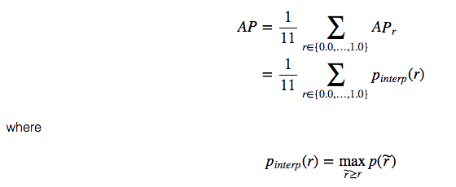
Step 4 - Calculate AP using 11 Point Interpolation Method
The 11 point interpolation method was introduced in the 2007 PASCAL VOC challenge.
Precision values are recorded across 11 equally spaced Recall values.
A prediction is positive if IoU ≥ 0.5.

Slide 16
Step 4 - Calculate AP using 11 Point Interpolation Method
First, we divide the recall value from 0 to 1.0 into 11 points — 0, 0.1, 0.2, …, 0.9 and 1.0.
Next, we compute the average of maximum precision value for these 11 recall values.
AP = 1/11 * Sum(11 point interpolated precision)
The interpolated Precision is the maximum Precision corresponding to the Recall value greater than the current Recall value.
In simple terms, it is the maximum precision value to the right.

Slide 17
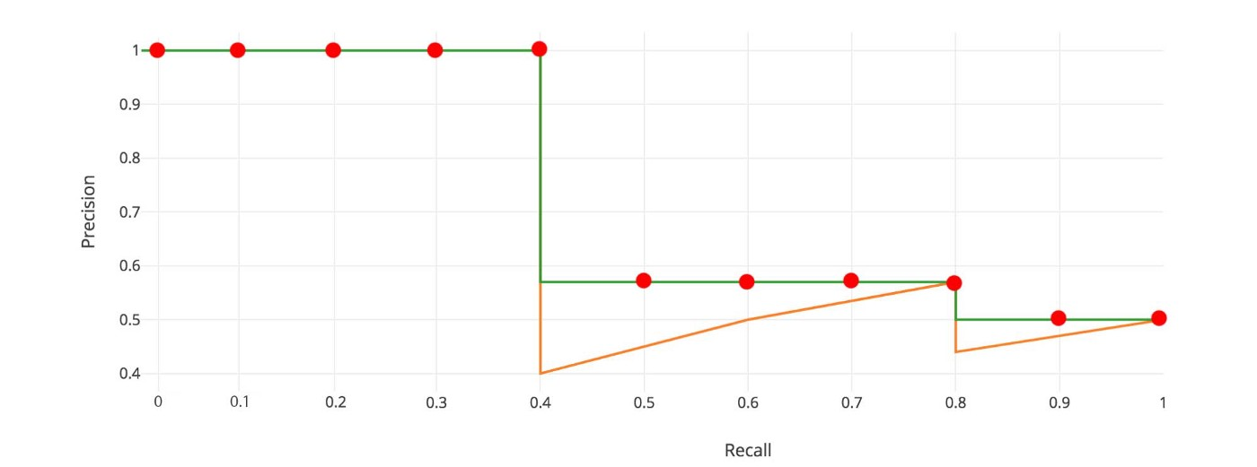
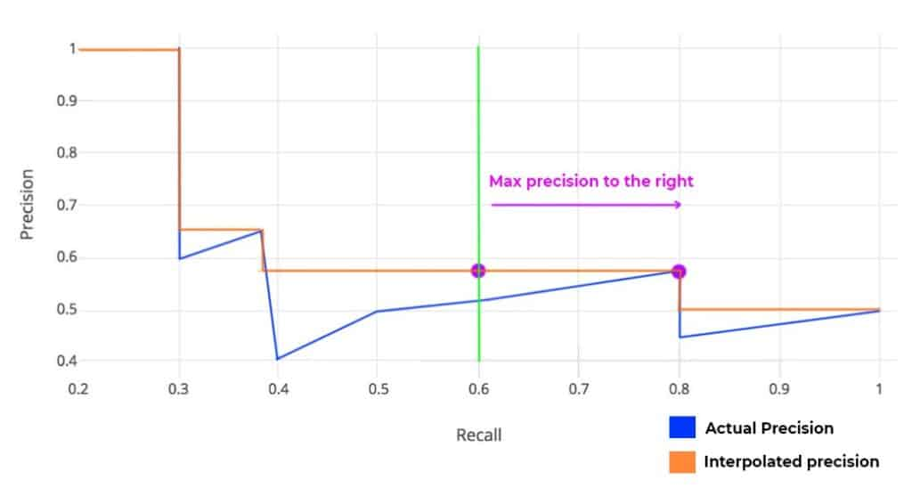

Slide 18
🤔Why Precision is interpolated only for 11 Recall points❓
Quoting from the paper, " The intention in interpolating the precision/recall curve in this way is to reduce the impact of the “wiggles” in the precision/recall curve, caused by small variations in the ranking of examples."
In reality, the evaluation dataset is huge. When we plot the graph for all predictions, the difference between adjacent points will be very very less. Hence, to compare two models, 11 point interpolation is sufficient.

Slide 19
🤔Is Average Precision (AP) calculated for all points as well❓
However, this interpolated method is an approximation which suffers from two issues.
First, It is less precise.
Second, it lost the capability in measuring the difference for methods with low AP. Therefore, a different AP calculation is adopted after 2008 for PASCAL VOC.

Slide 20
AP (Area under curve AUC)
For later Pascal VOC competitions, VOC2010–2012 samples the curve at all unique recall values (r₁, r₂, …), whenever the maximum precision value drops.
With this change, we are measuring the exact area under the precision-recall curve after the zigzags are removed.

Slide 21
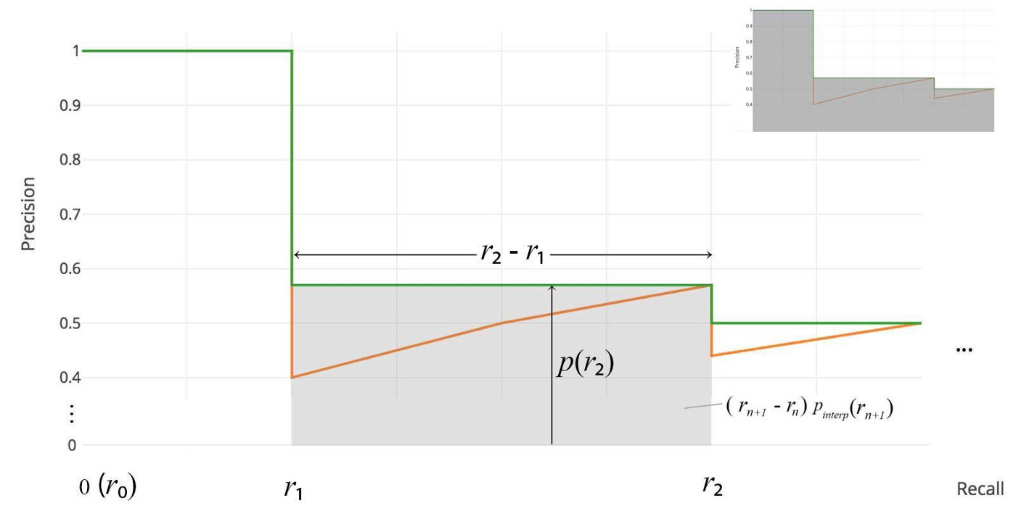

Slide 22

No approximation or interpolation is needed. Instead of sampling 11 points, we sample p(rᵢ) whenever it drops and compute AP as the sum of the rectangular blocks.
This definition is called the Area Under Curve (AUC).

Slide 23
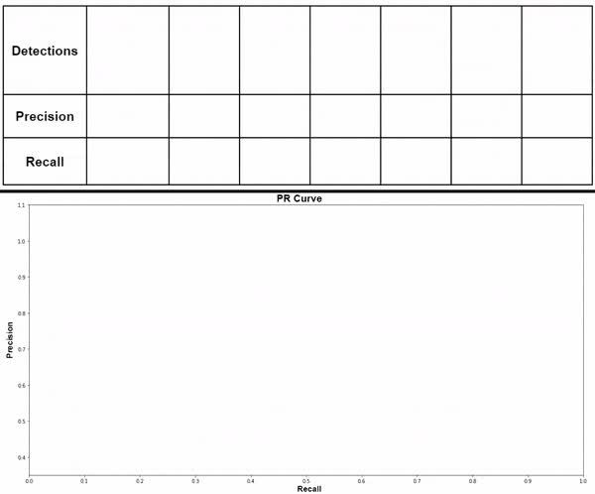
Step 5 - Plot Final Interpolated graph and calculate Average Precision for the Dog Class

Slide 24
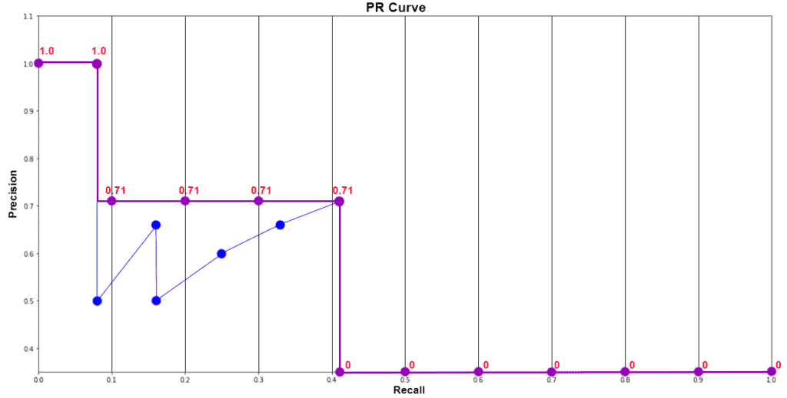
Step 5 - Plot Final Interpolated graph and calculate Average Precision for the Dog Class
APdog = 1/11 * ( Sum of 11 interpolated Precision values )
= 1/11 * (1 + 4*0.71 + 6*0)
= 0.349
= 34.9%

Slide 25
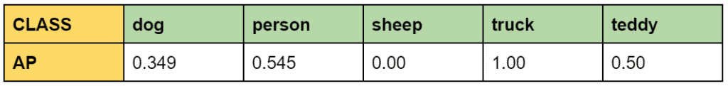
Similarly, we calculate Average Precision(AP) for person, teddy, sheep, and truck. Make sure to calculate AP for at least two classes below for clear understanding. Once done, we will proceed with calculating Mean Average Precision (mAP).

Slide 26
Mean Average Precision
Mean Average Precision or mAP is the average of AP over all detected classes.
mAP = 1/n * sum(AP), where n is the number of classes.

Slide 27
In the example above, we have 5 classes. Therefore, the calculated mAP is;
mAP = 1/5 * (0.349 + 0.545 + 0 + 1 + 0.5)
= 0.4788
= 47.88 %
To arrive at the mAP, while evaluating a model; Average Precision (AP) is calculated for each class separately.

Slide 28
🤔 Why Average Precision (AP) is it not calculated for all the classes at once❓
Let’s think about what happens if we do. You can go back to the detection chart and calculate the AP by combining all classes.
However, this time we would not be able to observe the class-wise performance. Consider a dataset having 3 classes, apple, bird, and butterfly.

Slide 29
🤔 Why Average Precision (AP) is it not calculated for all the classes at once❓
Let the number of training images be
1000 🍎, 20 🦜, and 1000 🦋 respectively.
The model is bound to perform poorly recognizing 🦜birds since their number is too small.
This can be identified only when per class AP is calculated.

Slide 30
101 Point Interpolation AP, MS COCO 2014 | COCO mAP
Until now the metrics introduced by PASCAL VOC were the standard benchmarking system.
However, with time models started saturating.
It was observed that even models with equivalent scores were not performing equally.

Slide 31
101 Point Interpolation AP, MS COCO 2014 | COCO mAP
MS COCO introduced 101 Point Interpolation AP in 2014.
It is a better approximation of AUC under the P-R curve..
Moreover, COCO made the challenge tougher by re-defining the mAP@0.5 to mAP@[0.5:0.05:0.95].
Earlier, mAP was evaluated only at IoU threshold 0.5.

Slide 32
101 Point Interpolation AP, MS COCO 2014 | COCO mAP
COCO mAP is calculated for a set of 10 different IoU thresholds and then averaged.
It ranges from 0.5 to 0.95 at a step frequency of 0.05.
Note that MS COCO defines Average Precision (AP) as mAP@[0.5:.05:.95].
Here, the terms AP and mAP are used interchangeably.

Slide 33
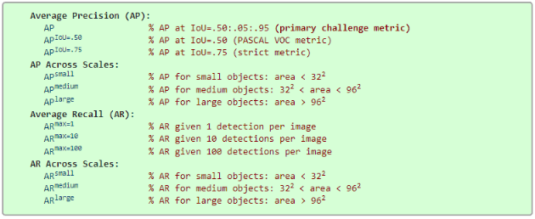
101 Point Interpolation AP, MS COCO 2014 | COCO mAP
Apart from this, MS COCO has 12 metrics for evaluating object detection models.

